Slide 1

Application Data Distribution in Edge Computing
RAVI SHANKAR – 170101053
UNDER THE GUIDANCE OF
DR. ARYABARTTA SAHU

Slide 2
Outline
Introduction and Industry Examples.
Problem Definition.
Solution Strategies.
Other Approaches in Comparison.
Experimental Results.
Implementations.
Conclusion.
Future Work.
References.

Slide 3
Introduction
Cloud Computing and Edge Computing.
Key issue for Cloud Migration.
Other conventional network paradigms like -
Content Centric Networks
Information Centric Networks
Content Delivery Networks
Application data distribution from app-vendors' perspective.

Slide 4
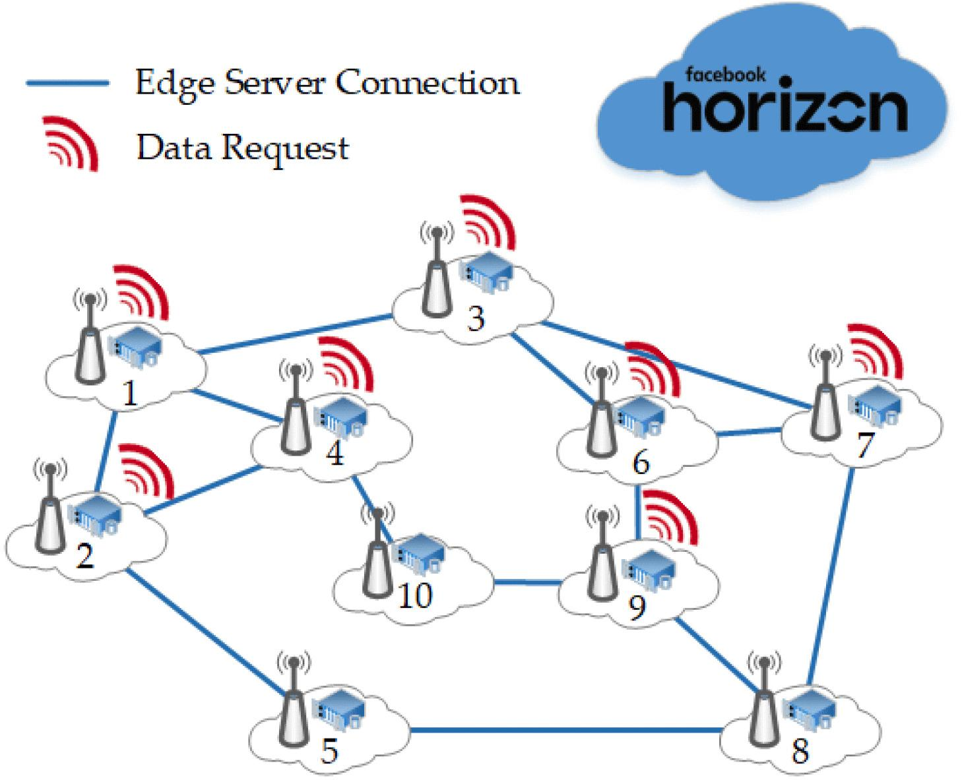
Industry Example
Facebook Horizon – VR videos and VR games.
VR applications are latency sensitive.
Cost-ineffective app-data distribution will be very expensive

Slide 5
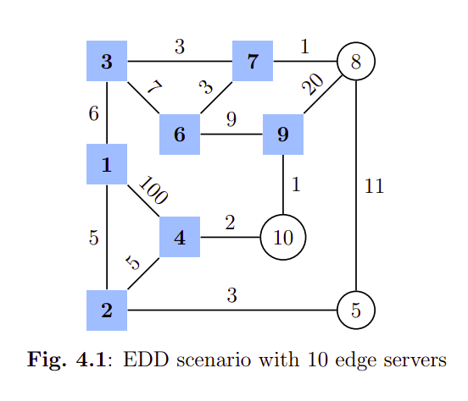
Problem Definition
We take N edge servers in a particular area and model it as a graph 𝐺.
For each edge server 𝑣, graph 𝐺 has a node 𝑣.
For each of the linked edge servers (𝑢,𝑣), graph 𝐺 has a corresponding edge 𝑒(u, v).
Thus, we use 𝐺(𝑉,𝐸,W) to represent the graph, where V is the set of nodes or edge servers in the graph, 𝐸 are the set of edges in the graph, and W is the set containing the weights corresponding to the edges.
Let 𝑅 denote the set of destination edge servers in graph 𝐺.

Slide 6
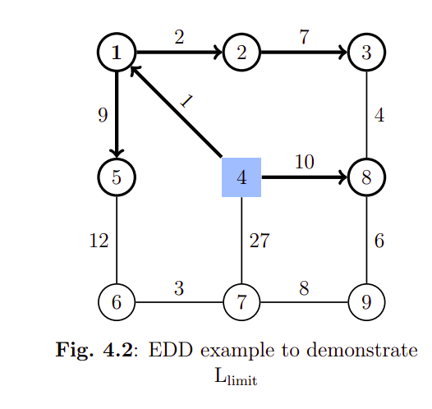
Problem Definition
Let L_{limit} be the vendors' EDD length constraint.
Two Possible Scenario – C2E and E2E.
We define a ratio λ to specify the constant weight for the cloud to edge server edges.

Slide 7
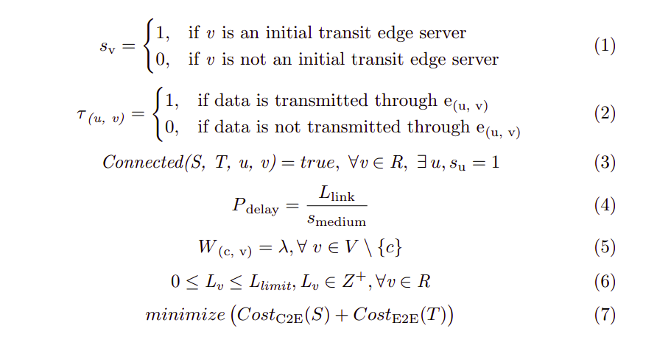
Problem Definition (Constraints)

Slide 8
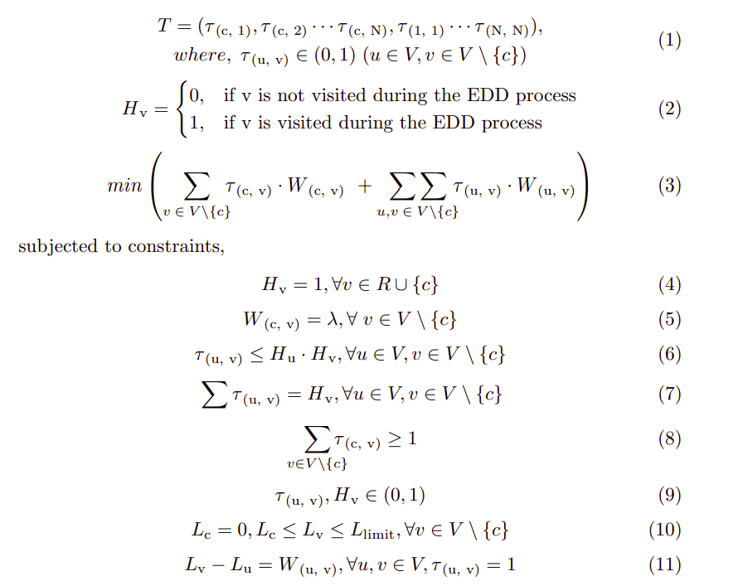
Solution Strategy – I
Edge Data Distribution as an Integer Programming Problem.
Minimize the total cost, subject to the given constraints.
This can then be solved by using any simple IP solver.
Eg: Pulp, GPLK, Gurobi, etc.

Slide 9
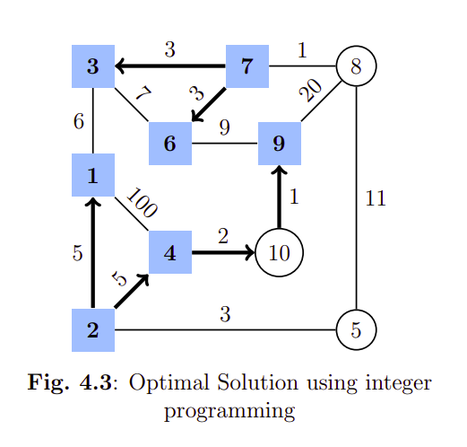
Optimal Solution Using Integer Programming
Edges C2E :– e_{(c, 2)} and e_{(c, 7)}.
Edges E2E :– e_{(2, 4)}, e_{(2, 1)}, e_{(4, 10)}, e_{(10, 9)} , e_{(7, 6)}, and e_{(7, 3)}.
L_{limit} = 110 and λ = 100 for the given example.
Total Cost = 219 units.

Slide 10
Solution Strategy - II
Edge Data Distribution as a Network Steiner Tree Approximation
Two Steps -
Calculate the Network Steiner Tree approximation on the given graph G
Use a heuristic algorithm to estimate a solution G', and then slice and fine tune the graph G' to form the final solution G_{final}
Must satisfy the EDD length constraint of L_{limit}

Slide 11
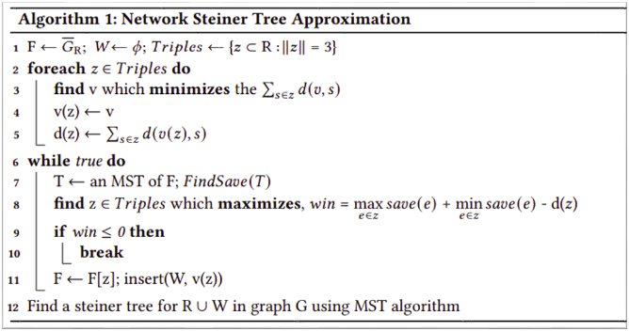
Step I: Network Steiner Tree Estimation
This algorithm is an O(11/6) approximation for the Steiner Tree.
The implementation time complexity is O(|V||E| + IRI⁴).

Slide 12
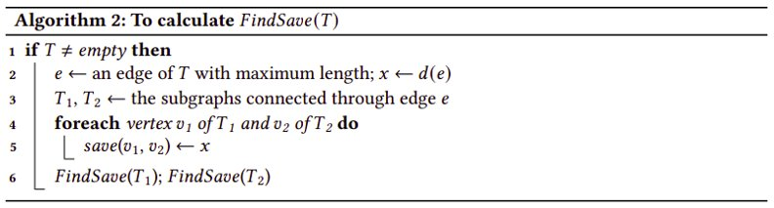
Step I: Network Steiner Tree Estimation
Algorithm 2 calculates the save matrix for the edge servers in T.
It is used estimate the maximum win for a given triple, where 𝑠𝑎𝑣𝑒 (𝑣1, 𝑣2) is the minimum value, such that both ends 𝑣1 and 𝑣2 are in the same component of 𝐹.
The implementation time complexity of this algorithm is O(|R|2).

Slide 13
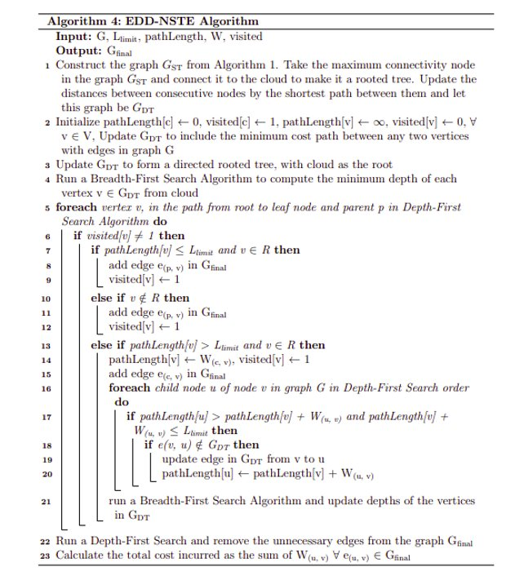
Step II: Slicing and Fine Tuning
The algorithm first initializes and runs simple BFS to construct the minimum depth of each vertex.
Then in each iteration of DFS, it adds or removes edges constrained on L_{limit}

Slide 14
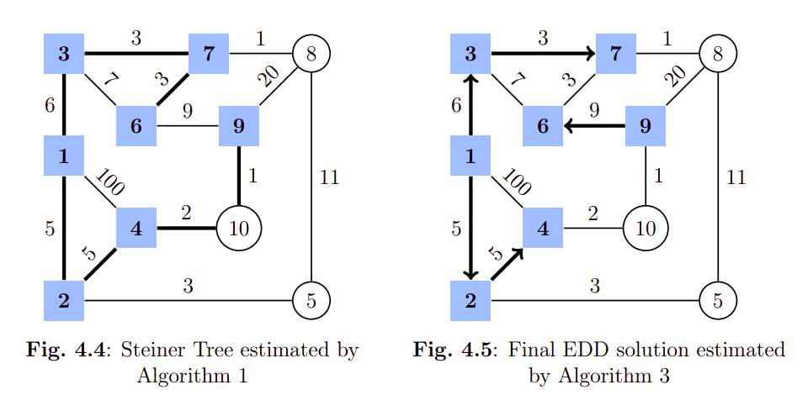
Example to understand EDD-NSTE

Slide 15
Simulation Settings and Approaches for comparison of the result
Greedy Connectivity (GC)
Random
EDD Integer Programming
Modified EDD – Approximation (EDD-A)
State of the art method, published in IEEE TPDS, Jan 2021.

Slide 16
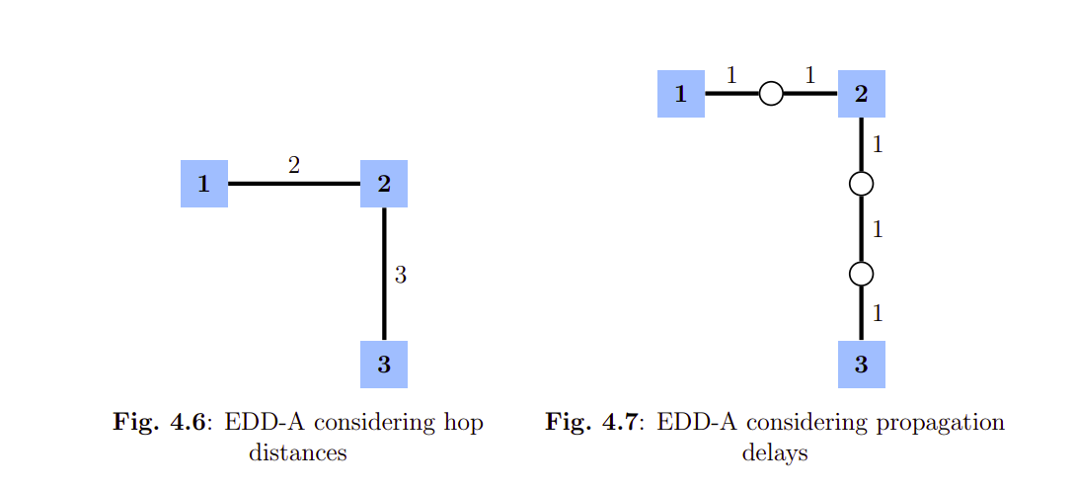
Modified EDD-A

Slide 17
Dataset Used and Experiments
The experiments were conducted on a widely used EUA and SLNDC Datasets.
All experimental were conducted on an Ubuntu 18.04.5 LTS machine equipped with Intel Core i5-7200U processor (4 CPU’s, 2.50GHz) and 16GB RAM. The integer programming simulation was done on Google Collab (Python 3 Google Computer Engine Backend, 12.72GB RAM).

Slide 18
Implementation
All above-mentioned solutions and approaches in comparison have been implemented.
Integer Programming Solution – Implemented using Google Collab Python-Pulp from scratch.
Greedy, Random, Modified EDD-A and EDD-NSTE – Implemented completely in C++ from scratch.
Link to the repository – GitHub

Slide 19
Experiment Results
Performed in two sets (based on dataset used) -
Set I – uses EUA (Edge User Allocation) dataset.
Set II – uses SLNDC (Stanford Large Network Dataset Collection) dataset.

Slide 20
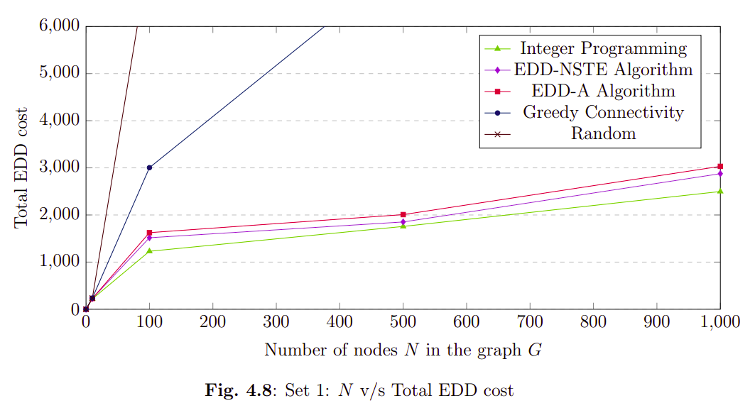
Set I – Number of nodes (N) vs Total EDD Cost incurred
With increase in the number of nodes N the total EDD cost incurred also increases.
EDD-NSTE outperforms all other heuristic simulations.

Slide 21
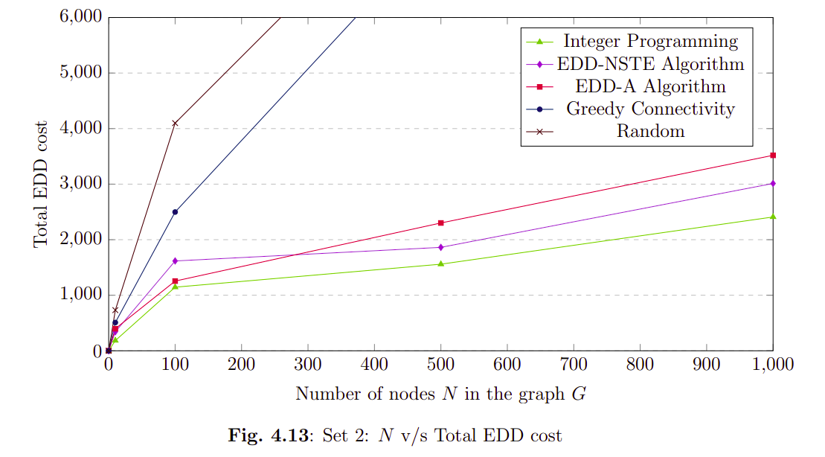
Set II – Number of nodes (N) vs Total EDD Cost incurred
With increase in the number of nodes N the total EDD cost incurred also increases.
EDD-NSTE outperforms all other heuristic simulations.
For N = 100, EDD-A here performs better than EDD-NSTE.

Slide 22
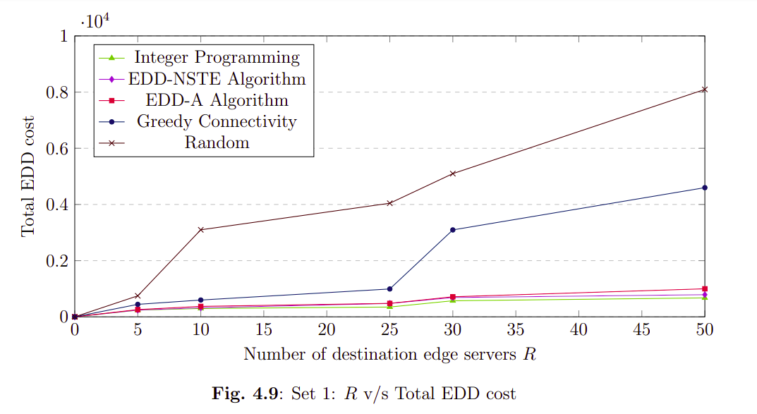
Set I – Number of destination Edge Servers (R) vs Total EDD Cost incurred
With increase in the number of destination edge servers R the total EDD cost incurred also increases.
EDD-NSTE and EDD-A outperforms all other heuristic simulations.
EDD-A and EDD-NSTE performs very close to each other.

Slide 23
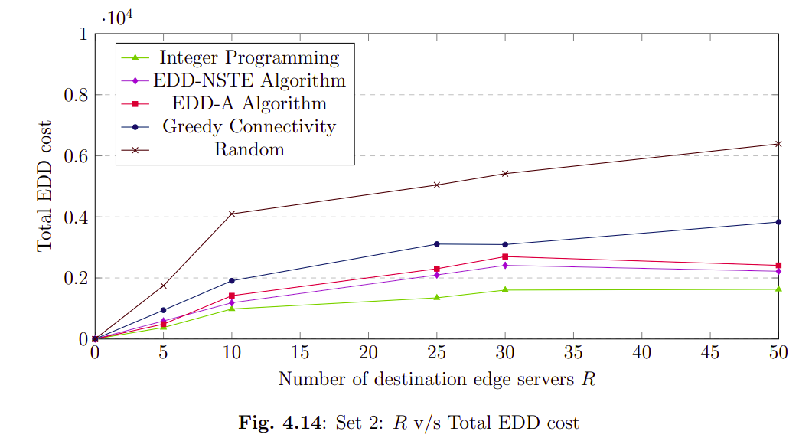
Set II – Number of destination Edge Servers (R) vs Total EDD Cost incurred
With increase in the number of destination edge servers R the total EDD cost incurred also increases.
EDD-NSTE outperforms all other heuristic simulations.
A clear distinction can be seen between EDD-A and EDD-NSTE.
For R = 5, EDD-A here performs better than EDD-NSTE.

Slide 24
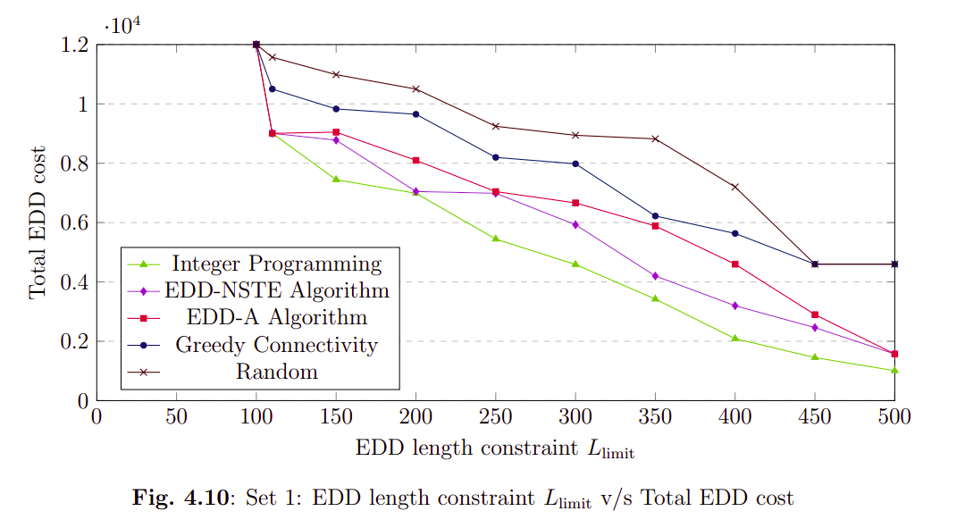
Set I – EDD length constraint (L_{limit}) vs Total EDD Cost incurred
With increase in the EDD length constraint the total EDD cost incurred decreases.
EDD-NSTE outperforms all other heuristic simulations.
A clear distinction can be seen between EDD-A and EDD-NSTE.

Slide 25
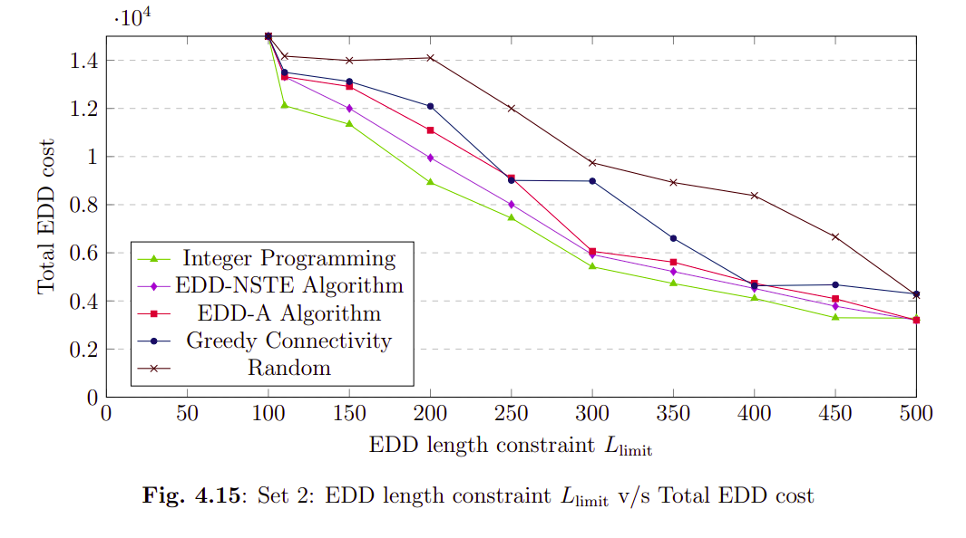
Set II – EDD length constraint (L_{limit}) vs Total EDD Cost incurred
With increase in the EDD length constraint the total EDD cost incurred decreases.
EDD-NSTE outperforms all other heuristic simulations.
After L_{limit} = 300, there isn't much difference between EDD cost estimated by EDD-A and EDD-NSTE.
At L_{limit} = 250, Greedy performs better than EDD-A

Slide 26
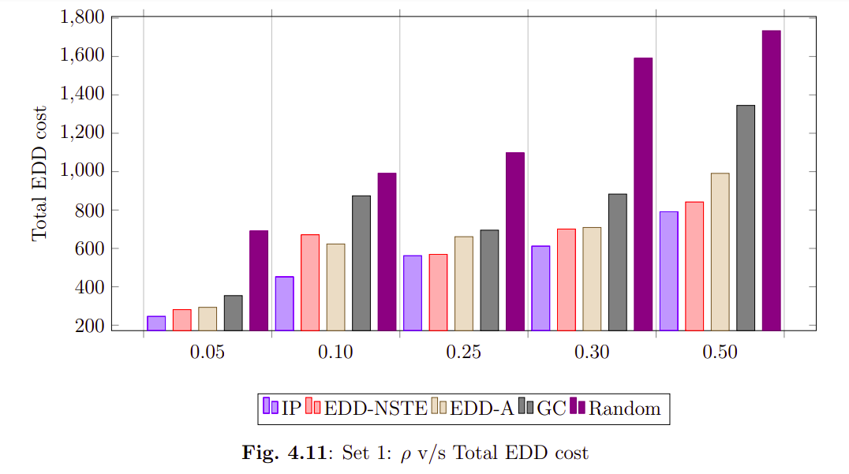
Set I: Destination edge server density vs Total EDD cost incurred
With increase in the destination edge server density the total EDD cost incurred increases (general trend).
EDD-NSTE almost outperforms all other heuristic simulations.
At density = 0.10, EDD-A performs better than EDD-NSTE.

Slide 27
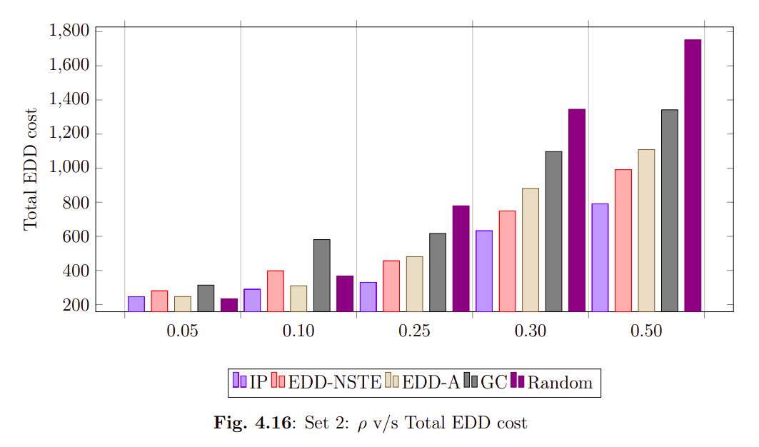
Set II: Destination edge server density vs Total EDD cost incurred
With increase in the destination edge server density the total EDD cost incurred increases (general trend).
EDD-NSTE almost outperforms all other heuristic simulations.
At density = 0.10, EDD-A performs better than EDD-NSTE, but the overall cost incurred here is higher than before.

Slide 28
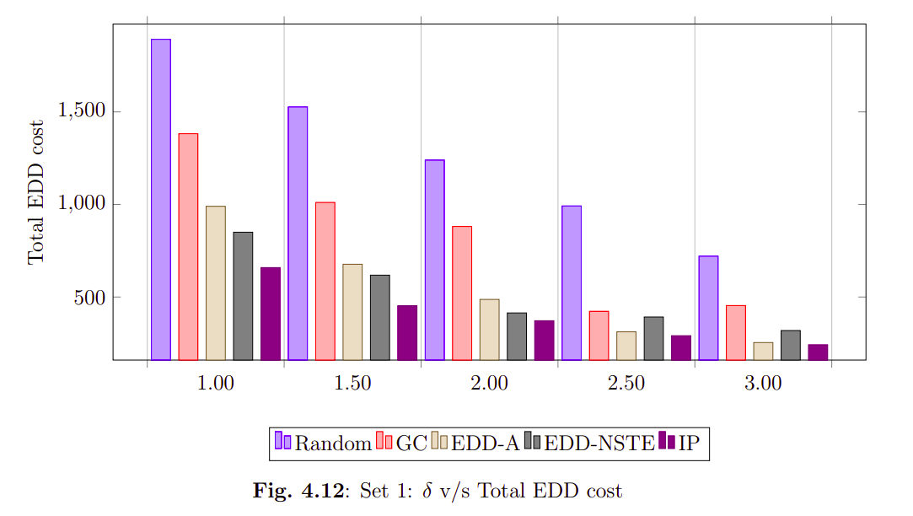
Set I: Edge density vs Total EDD cost incurred
With increase in the edge density the total EDD cost incurred decrease (general trend).
At density = 2.50, and density = 3.00, EDD-A performs better than EDD-NSTE.

Slide 29
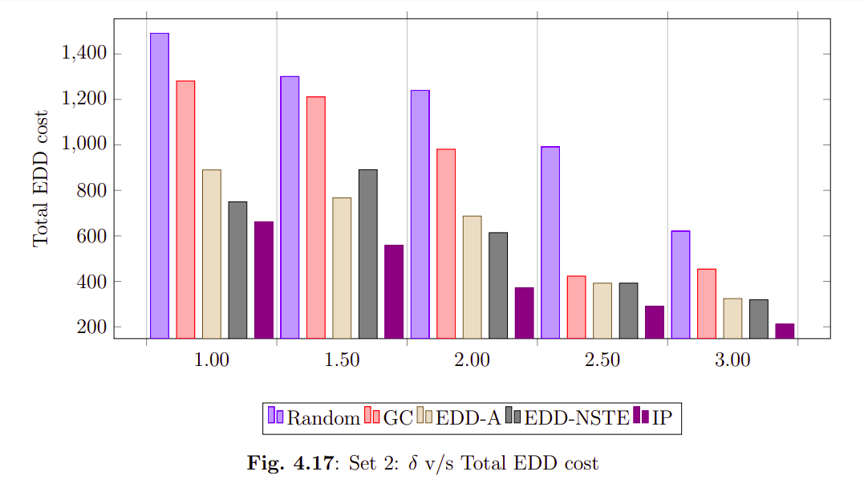
Set II: Destination edge server density vs Total EDD cost incurred
With increase in the destination edge server density the total EDD cost incurred increases (general trend).
EDD-NSTE almost outperforms all other heuristic simulations.
At density = 1.50, EDD-A performs better than EDD-NSTE, but the overall cost incurred here is lower than before.

Slide 30
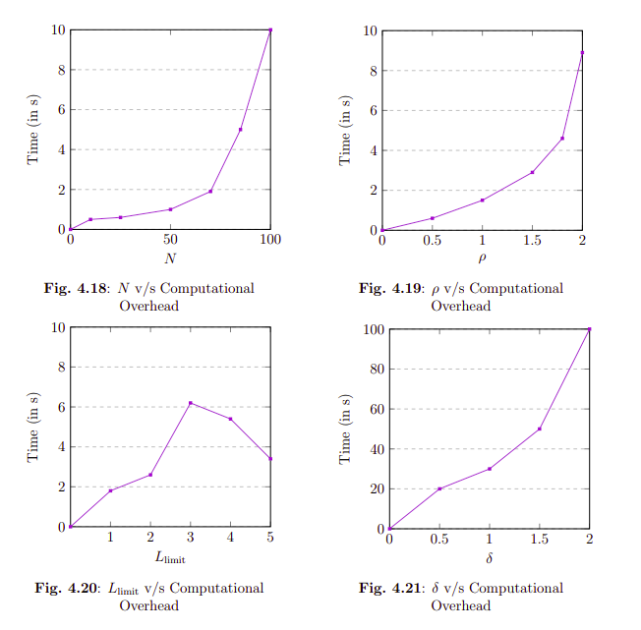
EDD-NSTE Time consumption vs different other parameters
With increase in N, destination edge server density, and edge density – the time taken by EDD-NSTE increases.
With increase in L_{limit}, the time taken first increases, then decreases.

Slide 31
Conclusion
The EDD-NSTE algorithm suggested in this report performs considerably better than the other simulations and approaches.
The algorithm also performs significantly better than the last best EDD-A algorithm suggested.
EDD-NSTE algorithm produced better solutions than EDD-A or other simulations in more than -
86.67% of the test cases (in case of hop distances)
80.35% of the test cases (in case of propagation delays)

Slide 32
Future work
Implementing a better way of estimating the Steiner Tree can help improve the approximation ratio.
A heuristic algorithm independent from Steiner Tree approximation.
Try and include other delays into the EDD problem formulation like transmission delays and queuing delays.

Slide 33
References
[BSEB] Martin Breitbach, Dominik Sch¨afer, Janick Edinger, and Christian Becker. Context-aware data and task placement in edge computing environments. In Proc. IEEE Int. Conf. Pervasive Comput. Commun., pp. 1-10, 2019
[CZP] Xuanyu Cao, Junshan Zhang, and H. Vincent Poor. An optimal auction mechanism for mobile edge caching. In Proc. 38th IEEE Int. Conf. Distrib. Comput. Syst., pp. 388-399, 2018.
[DGT+] Utsav Drolia, Katherine Guo, Jiaqi Tan, Rajeev Gandhi, and Priya Narasimhan. [DPW04] A. Davis, J. Parikh, and W. E. Weihl. Edge Computing: Extending Enterprise Applications to the Edge of the Internet. WWW Alt. ’04, page 180–187, 2004.
[FH] https://www.oculus.com/facebook-horizon/.
[GHNP01a] Clemens Gr¨opl, Stefan Hougardy, Till Nierhoff, and Hans J¨urgen Pr¨omel. Lower bounds for approximation algorithms for the steiner tree problem. Springer Verlag Berlin Heidelberg, 46(5):217–228, 2001.
[GHNP01b] Clemens Gr¨opl, Stefan Hougardy, Till Nierhoff, and J¨urgen Pr¨omel. Approximation algorithms for the steiner tree problems in graphs. Springer Verlag Berlin Heidelberg, 46(5):235–279, 2001.
[HFKT] Raluca Halalai, Pascal Felber, Anne-Marie Kermarrec, and Fran¸cois Ta¨ıani. Agar: A caching system for erasure-coded data. In Proc. 37th IEEE Int. Conf. Distrib. Comput. Syst., pp. 23-33, 2017.
[LHA+] Phu Lai, Qiang He, Mohamed Abdelrazek, Feifei Chen, and et al. Optimal edge user allocation in edge computing with variable sized vector bin packing. In Proc. Int. Conf. Service-Oriented Comput., pp. 230-245, 2018.
[LHGea20] Phu Lai, Qiang He, John Grundy, and et al. Cost-effective app user allocation in an edge computing environment. IEEE Transactions on Cloud Computing, 31(15):1–13, 2020.
[PB08] Mukaddim Pathan and Rajkumar Buyya. A Taxonomy of CDNs, pages 33–77. Springer Berlin Heidelberg, Berlin, Heidelberg, 2008.

Slide 34
[PB08] Mukaddim Pathan and Rajkumar Buyya. A Taxonomy of CDNs, pages 33–77. Springer Berlin Heidelberg, Berlin, Heidelberg, 2008.
[WWea20] Bastiaan Wissingh, Christopher A. Wood, and et al. Information-centric networking (ICN): content-centric networking (ccnx) and named data networking (NDN) terminology. RFC, 8793:1–17, 2020.
[XCH+21] HXiaoyu Xia, Feifei Chen, Qiang He, John C. Grundy, Mohamed Abdelrazek, and Hai Jin. Cost-Effective App Data Distribution in Edge Computing. IEEE Tran. on Parallel and Distributed Systems, 32(1):31–43, 2021.
[YBX+17] Hong Yao, Changmin Bai, Muzhou Xiong, Deze Zeng, and Zhangjie Fu. Heterogeneous cloudlet deployment and user-cloudlet association toward cost effective fog computing. Concurrency Comp. Pract. Exp., 29(16), 2017,.
[YZL+17] Hao Yin, Xu Zhang, Hongqiang H. Liu, Yan Luo, Chen Tian, Shuoyao Zhao, and Feng Li. Edge provisioning with flexible server placement. IEEE Trans. on Parallel Distribution System, 28(4):1031–1045, 2017.
[Zel93a] Alexander Z Zelikovsky. An 11/6-approximation algorithm for the network steiner problem. Algorithmica, 9(5):463–470, 1993.
[Zel93b] Alexander Z Zelikovsky. A faster approximation algorithm for the steiner tree problem in graphs. Information Processing Letters, 46(5):79–83, 1993.
[ZLH+18] Ke Zhang, Supeng Leng, Yejun He, Sabita Maharjan, and Yan Zhang. Cooperative Content Caching in 5G Networks with Mobile Edge Computing. IEEE Wireless Communications, 25(3):80–87, 2018.
[ZML18] Dongfang Zhao, Mohamed Mohamed, and Heiko Ludwig. Locality-aware scheduling for containers in cloud computing. IEEE Transactions on Cloud Computing, 8(2):635–646, 2018.
[ZZ18] Xi Zhang and Qixuan Zhu. Hierarchical caching for statistical QoS guaranteed multimedia transmissions over 5G edge computing mobile wireless networks. IEEE Wireless Comm., 25(3):12–20, 2018.
[SCZ+16] W. Shi, J. Cao, Q. Zhang, Y. Li, and L. Xu. Edge Computing: Vision and Challenges. IEEE Internet of Things Journal, 3(5):637–646, 2016.

Slide 35

Thank You

